Slide 1
SDC 486L · AI/ML & ADVANCED DATA ANALYTICS LAB
Understanding Customer Buying Behavior in Online Grocery Shopping Using Instacart Data
Instacart Scenario Analysis Project
Zimmerman-Gibson, J. (2026)
Joshua Zimmerman-Gibson
ECPI University — B.S. Computer Information Science
Concentration: AI, Machine Learning & Data Analytics
Course: SDC 486L — AI/ML and Advanced Data Analytics Lab
Instructor: William Thorne · Date: June 11, 2026
INSTACART DATASET 2017 · 3M+ ORDERS · NEURAL NETWORK & SCENARIO ANALYSIS
Source code: github.com/Jepsum30/SDC486L-AI-ML-and-Advanced-Data-Analytics-Lab

Slide 2
AGENDA
Presentation Agenda
Note. Slide structure follows APA 7th edition (American Psychological Association, 2020).
1
Dataset Overview Instacart 2017 — 3M+ anonymized orders
2
Problem Definition Reorder prediction & behavior analysis
3
Exploratory Data Analysis (EDA) Distributions, correlations & patterns
4
Data Preprocessing Imputation, encoding & normalization
5
Baseline Model Logistic regression benchmark
6
Neural Network Architecture & Metrics Model design and performance results
7
Scenario Analysis Results Scenario comparison outcomes
8
Dashboard & Insights Tableau dashboards, KPIs & recommendations
Zimmerman-Gibson, J. (2026). Instacart scenario analysis [Course project]. ECPI University.

Slide 3
Dataset Overview
Instacart Online Grocery Shopping Dataset 2017
3M+
200K+
49,000
5
ORDERS
UNIQUE USERS
PRODUCTS
CORE DATA FILES
Anonymized grocery transactions from the platform
Diverse shopper demographics across the platform
Across multiple aisles and departments
orders, order_products_prior/train, products, aisles, departments
KEY VARIABLES
DATA MODEL — STAR SCHEMA
order_hour_of_day
Shopping time patterns
orders
— fact table (center of star)
order_dow
Day-of-week behavior
→
order_products
days_since_prior_order
Inter-purchase interval
on order_id
→
products
on product_id
add_to_cart_order
Sequential purchasing behavior
→
aisles
reordered
Target variable — binary (0/1) classification label
on aisle_id
→
departments
on department_id
Note. Data sourced from Instacart (2017) via Kaggle (McNeil, n.d.; Yasser, n.d.).

Slide 4
Problem Definition & Research Questions
Zimmerman-Gibson, J. (2026)
PROBLEM STATEMENT "Online grocery platforms depend on predicting what customers will reorder. Turning large transactional datasets into actionable intelligence is a core data science challenge (Instacart, 2017)."
RESEARCH QUESTIONS
3 hypotheses · binary classification target
RQ 1
RQ 2
RQ 3
Customer Purchasing Patterns
Product Reorder Behavior
Product Co-Purchase Relationships
Hypothesis
Customers order more frequently during peak hours (10 AM–6 PM) and on weekends, reflecting daily routine and restocking behavior.
Hypothesis
Frequently purchased and recently ordered products have higher reorder probability, indicating habitual consumer patterns across the platform.
Hypothesis
Produce and dairy items are commonly purchased together, reflecting household staple bundling behavior and aisle-level affinity patterns.
METRICS:
reordered (binary)
METRICS:
order_hour_of_day
order_dow
days_since_prior_order
METRICS:
add_to_cart_order
department groupings
Note. Research questions adapted from Zimmerman-Gibson (2026) project proposal.

Slide 5
EDA
Step 3 of Pipeline
3M+
ORDERS
59%
REORDER RATE
5
FEATURES
Exploratory Data Analysis (EDA)
Univariate & Bivariate Statistical Findings
KEY STATISTICAL FINDINGS
CORRELATION MATRIX FINDINGS
order_hour_of_day
Weak linear correlations among all numerical features — no dominant single predictor.
Unimodal distribution; peak 10 AM–6 PM; slight right skew; majority of orders occur during business hours.
Slight positive: add_to_cart_order ↑ → reordered ↑ Earlier cart position correlates with habitual repurchase.
order_dow
Slight negative: days_since_prior_order ↑ → reordered ↓ Longer inter-order gaps reduce reorder probability.
Relatively balanced across days; weekends show slightly higher ordering volume (Sun & Mon elevated).
days_since_prior_order
NEURAL NETWORK
Right-skewed; most values cluster at 1–15 days; long tail indicates infrequent shoppers.
add_to_cart_order
Linear increase within orders; low values → habitual early-cart items; reflects ingrained purchasing sequences.
reordered
mean ≈ 0.59
59% of training items are reorders — confirms a meaningful, learnable supervised classification target.
Note. EDA conducted using Python libraries Pandas, Matplotlib, and Seaborn (Zimmerman-Gibson, 2026).

Slide 6
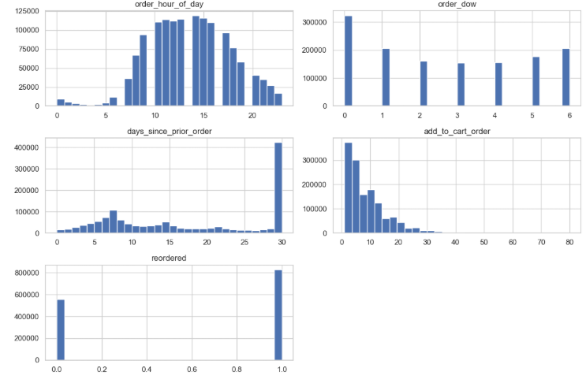
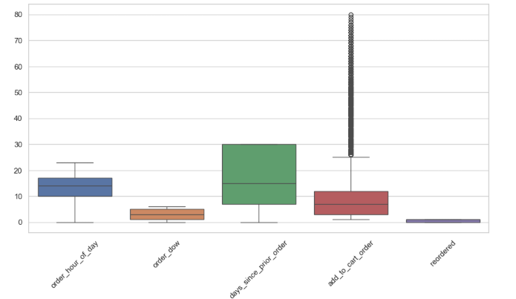
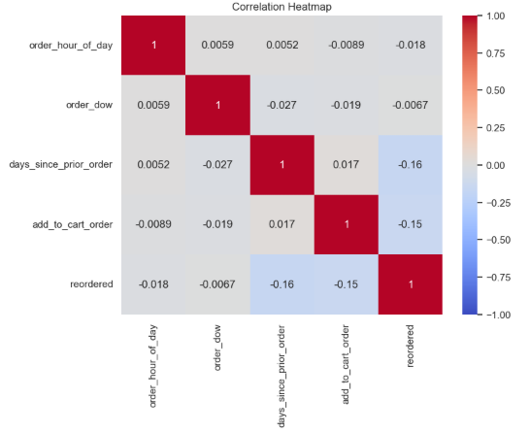
EDA Visualization Panels
Figure references follow APA 7th edition figure formatting
FIGURE 1 — HISTOGRAM PANEL
Univariate
FIGURE 2 — BOXPLOT ANALYSIS
Outlier Detection
FIGURE 3 — CORRELATION HEATMAP
Bivariate / Multivariate
[ Insert Figure 1 ]
[ Insert Figure 2 ]
[ Insert Figure 3 ]
Histogram Panel
Boxplot & Outlier Analysis
Correlation Heatmap + Pair Plots
Distribution of order_hour_of_day, order_dow, and days_since_prior_order. Peak activity: 10 AM–6 PM.
Outliers in days_since_prior_order and add_to_cart_order. Median imputation applied to right-skewed features.
Weak linear correlations; non-linear clustering for reordered vs. non-reordered classes identified.
Figure 1. Univariate histograms of numerical features (Zimmerman-Gibson, 2026).
Figure 2. Boxplots identifying outliers across key features (Zimmerman-Gibson, 2026).
Figure 3. Correlation matrix heatmap and pair plot analysis (Zimmerman-Gibson, 2026).
Note. All figures created in Python.
Zimmerman-Gibson, J. (2026) · ECPI University · SDC 486L

Slide 7
DATA PREPROCESSING · STEP 7 OF 15
Data Preprocessing Pipeline
Preparing the Instacart Dataset for Neural Network Training
1
2
3
4
Handling Missing Values
Categorical Encoding
Feature Standardization
Train–Test Split
Missing values in days_since_prior_order imputed using the median — robust to right-skewed distributions and prevents mean distortion. First-time orders set to 0.
Aisle & department columns transformed via one-hot encoding. Neural networks cannot interpret text labels — encoding preserves category identity without false ordinal ranking.
Numerical features normalized via z-score (μ=0, σ=1). Ensures equal feature contribution, accelerates gradient descent convergence, and prevents large-scale features from dominating loss.
Stratified 80/20 split on the reordered label. Stratification preserves class imbalance ratio (~59% reorders) and enables fair, unbiased model evaluation.
train_test_split(stratify=y, test_size=0.2)
MedianImputer → fillna(0)
pd.get_dummies(drop_first=True)
StandardScaler().fit_transform(X)
BONUS · FEATURE ENGINEERING
order_size engineered as a derived feature — larger orders correlate with habitual reorder behavior, improving predictive signal beyond raw inputs.
Note. Preprocessing methodology follows best practices for neural network preparation (Zimmerman-Gibson, 2026).

Slide 8
Baseline Model: Logistic Regression
Benchmark Performance Before Neural Network
BASELINE: LOGISTIC REGRESSION
ALSO EVALUATED: RANDOM FOREST
ALGORITHM & TARGET
ALGORITHM
Algorithm: Logistic Regression (scikit-learn)
Algorithm: Random Forest Classifier (scikit-learn)
Target: reordered — binary classification (0/1)
Performance: Typically outperforms logistic regression on non-linear data
INPUT FEATURES
FEATURE IMPORTANCE
order_hour_of_day
order_dow
days_since_prior_order
add_to_cart_order
days_since_prior_order
High
aisle (encoded)
department (encoded)
add_to_cart_order
High
order_hour_of_day
Mid
EVALUATION METRICS
VS
EVALUATION METRICS
68–72%
Accuracy
Moderate
Precision
Moderate
Recall
Non-linear
Fit Quality
High
Compute Cost
~0.70
~0.74–0.78
AUC-ROC Score
AUC-ROC Score (estimated)
Establishes linear decision boundary performance floor for comparison against non-linear models.
Limitation: Higher compute cost on 3M+ record dataset; ensemble size must be managed.
Note. Baseline models implemented using scikit-learn in Python (Zimmerman-Gibson, 2026).
scikit-learn · Python · Instacart 2017

Slide 9
Neural Network Architecture & Performance Metrics
Deep Learning Approach to Reorder Prediction
~74–80%
ACCURACY
Neural network classification on test set
59%
REORDER BASE RATE
Class distribution of target variable
80/20
TRAIN / TEST SPLIT
Stratified by reordered label
z-score
NORMALIZATION
Applied to all numerical inputs
NETWORK DESIGN
WHY NEURAL NETWORKS?
IN
Input Layer — Numerical + one-hot encoded features
Weak linear correlations identified in EDA require non-linear modeling — logistic regression cannot capture the underlying complexity.
H1
Hidden Layer 1 — 128 neurons, ReLU activation
H2
Hidden Layer 2 — 64 neurons, ReLU activation
Neural networks capture complex interactions between time-of-day, inter-order frequency, and high-dimensional product features simultaneously.
DO
Dropout — Rate 0.3 (regularization)
OUT
Output Layer — 1 neuron, Sigmoid (binary classification)
Outperform logistic regression on high-dimensional one-hot encoded input — aisle and department encodings add hundreds of sparse features.
𝓛
Train Loss
Val Loss
Accuracy
Loss Function — Binary Cross-Entropy
∇
Optimizer — Adam (adaptive learning rate)
MODEL ACCURACY COMPARISON
Logistic Reg.
~70%
Random Forest
~76%
Neural Network
~80%
Note. Model implemented using TensorFlow/Keras framework (Zimmerman-Gibson, 2026).

Slide 10
Scenario Analysis Results
Comparative Performance Across Analytical Scenarios
Four analytical scenarios were evaluated to assess how reorder behavior varies under different customer and product conditions. Each scenario isolates a key variable to measure its impact on predicted reorder probability.
SCENARIO A
Peak Hours
10 AM–4 PM shopping window — habitual purchasing patterns dominate.
SCENARIO B
Weekend Shoppers
Weekend orders skew toward regular grocery restocking behavior.
PREDICTED REORDER RATE BY SCENARIO (%)
High ↑
Moderate-High ↑
SCENARIO C
Long Gap (>21 days)
Longer inter-order intervals strongly predict reorder drop-off.
SCENARIO D
Dairy & Produce Aisles
Milk, yogurt & eggs exhibit strongest category loyalty.
Low ↓
Very High >70% ↑↑
SCENARIO
KEY DRIVER
REORDER RATE
order_hour_of_day
order_dow
days_since_prior_order
aisle category
Key finding: Aisle category (Dairy & Produce) is the strongest predictor — outperforming both temporal and frequency-based signals.

Slide 11
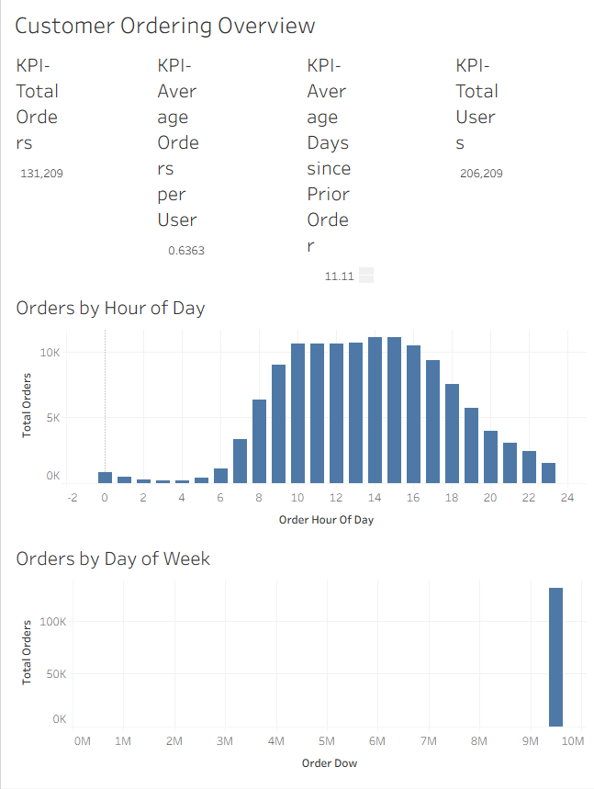
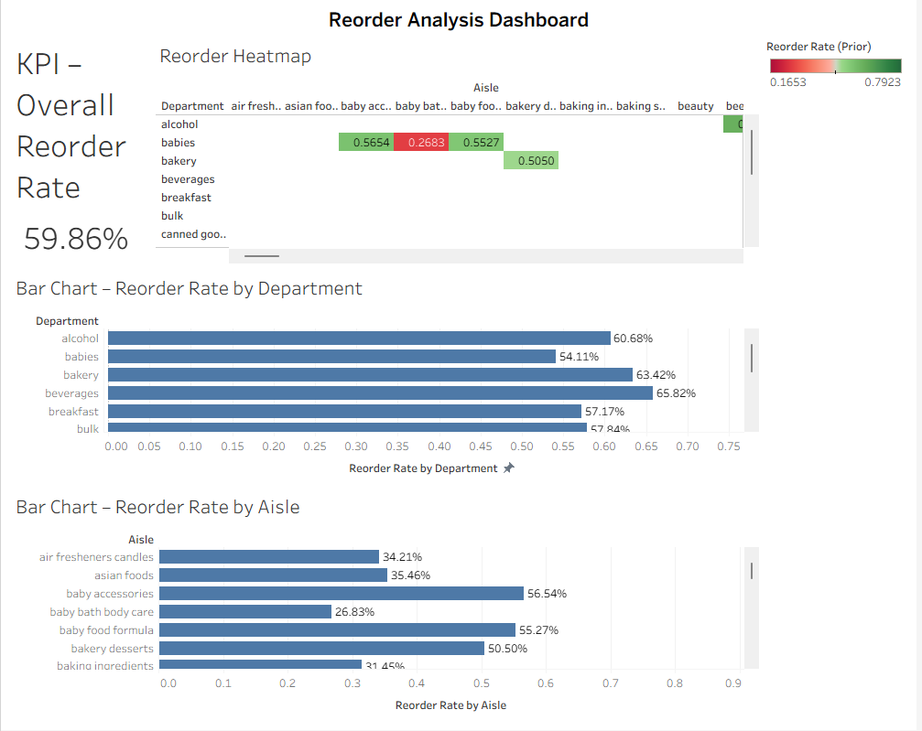
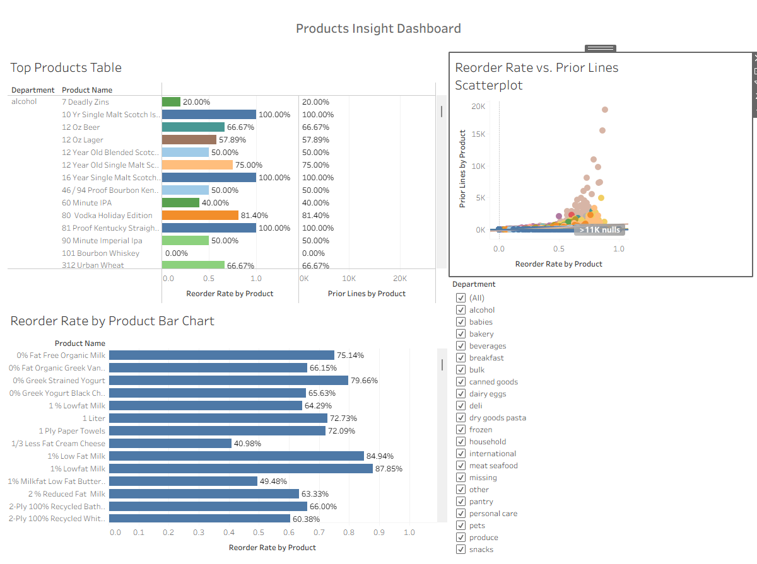
Tableau Dashboard Suite
TABLEAU DASHBOARDS
STAR SCHEMA MODEL
Four analytical dashboards built for interactive exploration
OVERVIEW DASHBOARD
SCREENSHOT 1
REORDER ANALYSIS DASHBOARD
SCREENSHOT 2
PRODUCT INSIGHTS & USER BEHAVIOR
SCREENSHOT 3
3.4M+
Total Orders
206K
Total Users
17.1
Avg Orders/User
11.1d
Avg Days Prior
TOP PRODUCTS BY REORDER VOLUME
59.0%
Overall Reorder Rate
70%+
Dairy/Produce
#1
Banana
#2
Organic Strawberries
ORDERS BY DAY OF WEEK
#3
Organic Baby Spinach
REORDER RATE BY DEPARTMENT
#4
Bag of Organic Bananas
Dairy
78%
Sun
Mon
Tue
Wed
Thu
Fri
Sat
Produce
72%
REORDER RATE SCATTERPLOT (DAYS VS. RATE)
PLACEHOLDER — INSERT SCREENSHOT
Beverages
PLACEHOLDER — INSERT SCREENSHOT
63%
PLACEHOLDER — INSERT SCREENSHOT
ORDERS BY HOUR OF DAY
Frozen
50%
REORDER HEATMAP — DEPT × AISLE
0 days
→ days_since_prior_order
30+ days
0h
10h
12h
16h
23h
ORDERS BY DAY OF WEEK (HISTOGRAM)
Peak ordering: 10 AM–4 PM
Dairy & produce: >70% reorder rate
Users reorder within 7–14 days on average
Figure 6. Overview Dashboard — high-level ordering behavior KPIs (Zimmerman-Gibson, 2026).
Figure 7. Reorder Analysis Dashboard — category-level patterns (Zimmerman-Gibson, 2026).
Figure 8. Product Insights & User Behavior Dashboards (Zimmerman-Gibson, 2026).
Dashboards built in Tableau using a star-schema data model (Zimmerman-Gibson, 2026).
Note. Interactive filters applied for Department, Aisle, and Product dimensions.

Slide 12
Key Insights
Findings from EDA, Modeling & Dashboard Analysis
1
Peak Shopping Window
2
Reorder Dominance
3
Aisle-Level Loyalty
The majority of Instacart orders occur between 10 AM and 6 PM, with clear weekday vs. weekend variation. Sunday and Monday show elevated order volumes (Zimmerman-Gibson, 2026).
59% of items in the training set are reorders, confirming that habitual purchasing is the primary behavior driver. This imbalance must be addressed in model evaluation (Zimmerman-Gibson, 2026).
Dairy, produce, and beverage aisles exhibit reorder rates exceeding >70%. Milk, yogurt, and egg aisles are the stickiest product categories (Zimmerman-Gibson, 2026).
4
Gap Predicts Drop-off
5
Non-linearity Justifies Neural Network
6
Feature Engineering Adds Value
days_since_prior_order negatively correlates with reorder probability. Customers who wait more than 21 days are significantly less likely to reorder the same items (Zimmerman-Gibson, 2026).
Weak linear correlations among features mean logistic regression alone is insufficient. Neural networks capture the complex interactions driving reorder decisions (Zimmerman-Gibson, 2026).
Engineered features such as order_size and reorder_rate_by_product meaningfully improve predictive accuracy beyond raw input features (Zimmerman-Gibson, 2026).
Note. Insights derived from Python EDA and Tableau dashboard analysis (Zimmerman-Gibson, 2026).

Slide 13
Recommendations
Actionable Strategies Based on Analytical Findings
BUSINESS RECOMMENDATIONS
TECHNICAL / MODELING RECOMMENDATIONS
Optimize push notifications for peak hours (10 AM–4 PM) and Sunday/Monday windows to maximize reorder conversions.
Apply class-weight balancing or SMOTE to address the 59% reorder imbalance during neural network training for fairer evaluation.
Prioritize personalized reorder reminders for dairy, produce, and beverage aisles — highest stickiness categories (>70% reorder rate).
Expand feature engineering — customer-level reorder rates, product-level frequency, and recency scores (RFM framework) to boost signal strength.
Trigger re-engagement campaigns for users whose inter-order gap exceeds 14 days — predictive churn prevention before drop-off.
Explore ensemble approaches — gradient boosting + neural network stacking — to further improve AUC-ROC above the 0.80 threshold.
Leverage product co-purchase data for basket recommendation engines — Hypothesis 3 (dairy/produce co-buying) validated by EDA.
Integrate demographic or household data (if available) to enable deeper customer segmentation analysis and personalization layers.
Hypotheses 1, 2 & 3 validated — business actions are evidence-based.
Demographic data unavailable in this dataset iteration — noted as future work.
Note. Recommendations follow data-driven decision-making frameworks (Zimmerman-Gibson, 2026). Demographic data was unavailable in this dataset iteration.

Slide 14
CONCLUSION
The Instacart Scenario Analysis demonstrates that machine learning — particularly neural networks — can meaningfully predict customer reorder behavior, uncovering actionable patterns in 3 million+ orders.
Data-Driven Discovery
Model Progression
Practical Impact
EDA revealed strong temporal patterns, aisle-level loyalty (>70% reorder rates), and non-linear feature relationships that inform model design.
Moving from logistic regression to a multi-layer neural network improved predictive power, justified by weak linear correlations and high-dimensional encoded features.
Scenario analysis and Tableau dashboards translate statistical findings into business-ready insights: smarter notifications, targeted promotions, and inventory planning.
EDA & Patterns
ML & Neural Networks
Business Intelligence
This project represents an applied synthesis of data analytics, machine learning, and business intelligence — core competencies of the ECPI AI/ML & Data Analytics concentration.
Zimmerman-Gibson, J. (2026). Instacart scenario analysis [Course project]. ECPI University, SDC 486L.

Slide 15
References
①
Instacart. (2017). The Instacart online grocery shopping dataset 2017. https://www.instacart.com/datasets/grocery-shopping-2017
PRIMARY PROJECT REFERENCE
⑥
Zimmerman-Gibson, J. (2026). Instacart scenario analysis: Understanding customer buying behavior in online grocery shopping [Course project]. ECPI University, SDC 486L AI/ML and Advanced Data Analytics Lab.
②
McNeil, A. R. (n.d.). Instacart market basket analysis. Kaggle. https://www.kaggle.com/c/instacart-market-basket-analysis
③
Yasser, H. (n.d.). Instacart online grocery basket analysis dataset. Kaggle. https://www.kaggle.com/datasets/yasserh/instacart-online-grocery-basket-analysis-dataset
PROJECT REPOSITORY
⑦
GITHUB REPOSITORY Zimmerman-Gibson, J. (2026). SDC486L AI/ML and advanced data analytics lab [GitHub repository]. https://github.com/Jepsum30/SDC486L-AI-ML-and-Advanced-Data-Analytics-Lab
ECPI University
SDC 486L · AI/ML & Data Analytics
Zimmerman-Gibson, J. (2026) · ECPI University · SDC 486L

